Slide 1
BDR

Slide 3
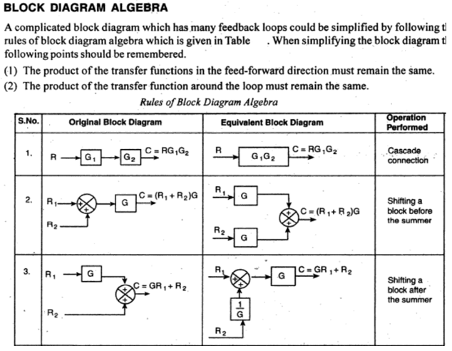
Review of Block Diagram Algebra

Slide 4
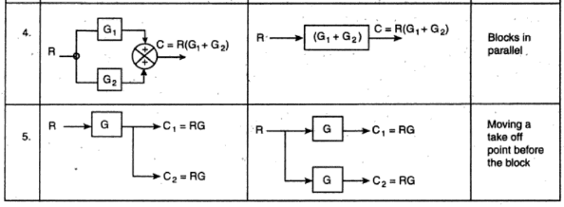
Review of Block Diagram Algebra

Slide 5
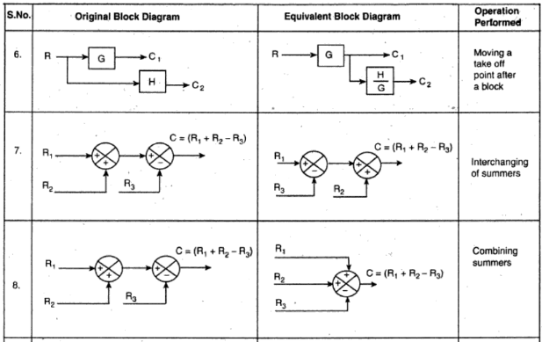
Review of Block Diagram Algebra

Slide 6
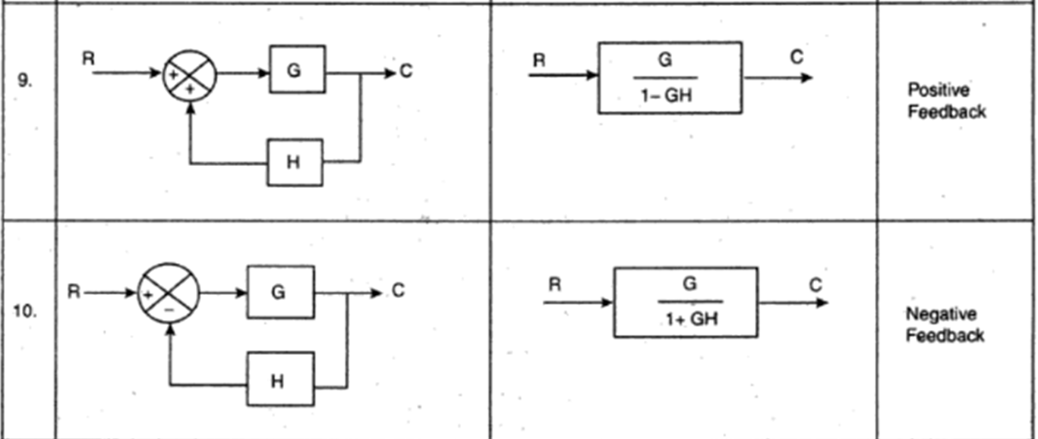

Slide 7

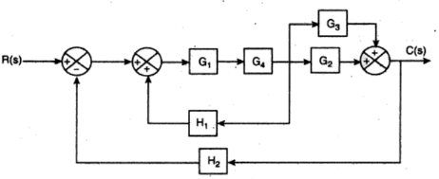

Problems in BDR – TO PRACTICE

Slide 8
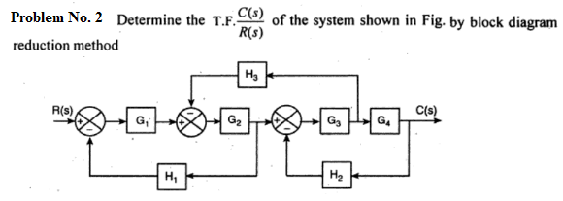

Problems in Block Diagram Reduction

